Slide 1
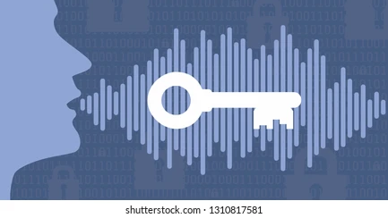

Voice Biometric

Slide 2
Voice biometric Vs Speech recognition
Speech recognition
It converts speech to text and gives the result. Simple!!!!
Voice recognition
It compares the frequency of voice and is the main key in authentication

Slide 3
Voice recognition algorithm
Two popular sets of features are used in the analysis of the speech signal
1.MFCC
2.LPCC
Continued..

Slide 4
How this features works
The rate of vibration determines the pitch of the voice.
In order for the sound to be clear and not raspy or hoarse, the vocal folds must vibrate together symmetrically and regularly
When the voice is hoarse, the vocal folds may not be closing fully, or may not be vibrating symmetrically
Other uses
i. Bomb explosion
ii. Earthquakes

Slide 5
AI for Voice biometrics
Google’s Alexa and Apple’s Siri are AI based apps used in voice biometrics
Also Amazon has introduced new SDK so that developers can use Python in addition to Java and Node.
Your code is written in Node.js for the Skill Service which lives in the Cloud (Amazon AWS, Lambda, an HTTPS service). It receives instructions to determine the actions to take in response to the user requests from the Alexa enabled device.

Slide 6
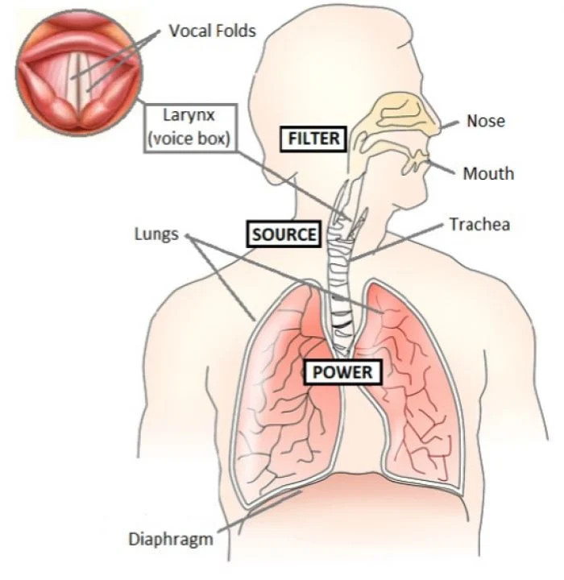
Science behind Voice biometrics
There are 70 body parts which are responsible for creating a voice.

Slide 7
Javascript Pseudo for Voice biometrics
<!DOCTYPE html>
<html lang="en">
<head>
<meta charset="UTF-8">
<meta name="viewport" content=
"width=device-width, initial-scale=1.0">
<title>Speech to Text</title>
</head>
<body>
<div class="words" contenteditable>
<p id="p"></p>
</div>
<script>
var speech = true;
window.SpeechRecognition = window.SpeechRecognition
|| window.webkitSpeechRecognition;
const recognition = new SpeechRecognition();
recognition.interimResults = true;
const words = document.querySelector('.words');
words.appendChild(p);
Continued..

Slide 8
recognition.addEventListener('result', e => { const transcript = Array.from(e.results) .map(result => result[0]) .map(result => result.transcript) .join('') document.getElementById("p").innerHTML = transcript; console.log(transcript); }); if (speech == true) { recognition.start(); recognition.addEventListener('end', recognition.start); } </script> </body> </html>

Slide 9
Thank you!!

